Slide 1
Unison AGM 13th March 2018 1-3pm Arts LR1 Chaired by Ioana Cerasella Chis

Slide 2
Agenda
Chair’s opening statement – a retrospective look at 2017/2018
Officer elections (nominations and voting)
Health and Safety & Treasurer Reports
Motion: Senior Staff Pay and the Living Wage
Hotel and Conference Park – updates; Hotel and Conference Park member & Matt
Secretary’s update
Guest speaker: Dr Roland Brandstaetter (UoB UCU President) + Q&A
Chair’s closing statement
Notes:
Elections – candidates for each role; nominations, voting

Slide 3
2017/2018 committee – officers & stewards
Branch officers
Branch Secretary: Matthew Raine - matthewraine@outlook.com / 0790 496 0442
Deputy Branch Secretary: Lee Crutchley - l.crutchley@bham.ac.uk / 07709 583846
Chair (shared role): Joe Ward & Ioana Cerasella Chis ioana.cerasella.chis@gmail.com
Treasurer: David Piela - dpiela3@gmail.com
Health & Safety Officer: Michael Moore - m.moore.1@bham.ac.uk / 07964926949
Communications Officer: Vera Kubenz - v.kub@gmx.net (stepped down in 2018)
Academic Liaison Officer: Ioana Cerasella Chis ioana.cerasella.chis@gmail.com
Women’s Officer: Alison Dingle – a.dingle@bham.ac.uk
Stewards
Library Services: Michael Moore - m.moore.1@bham.ac.uk
Academic Services (except library): David Piela - dpiela3@gmail.com
College of Social Sciences: Matthew Raine - matthewraine@outlook.com / 0790 496 0442
Cleaning: Douglas Graham
Security: Rob Whitehouse

Slide 4
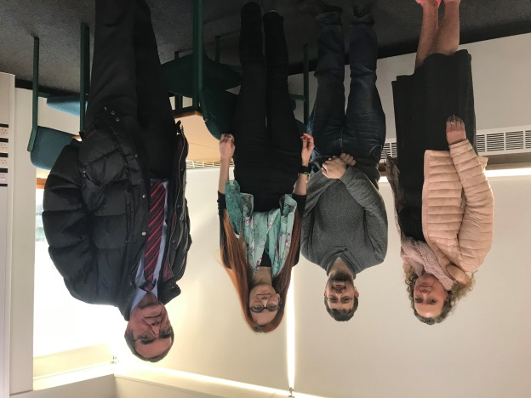
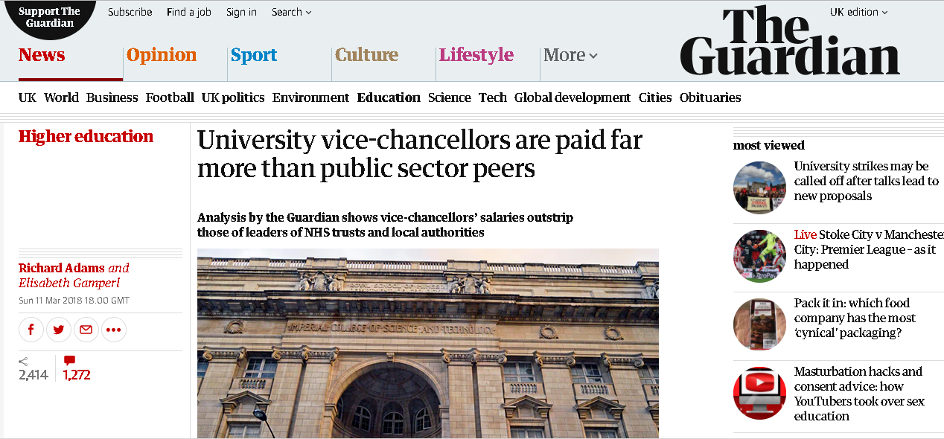
The UoB context * profit last year: £83 million * VC salary (£439,000/year + £90,000 as Chair of USS pension scheme) * no staff representation on University Council=no democracy on campus
David Eastwood - one of the highest paid VCs in the country
Conflict of interest due to executive directorship at INTO (student recruitment company)
Sits on his own remuneration committee
The University is not a Living Wage Accredited Employer - 500 staff are paid below the Real Living Wage of £8.75/hour.
Pay rises at UoB have been for years below inflation. It would cost UoB less than £3m to give all support staff a 5% pay rise.
Sick pay and annual leave under attack - used by management as bargaining chips in pay negotiations.
Meeting with MP Roger Godsiff on the Living Wage
Asked in Jan 2018 by a student: ‘when are you going to resign?’

Slide 5
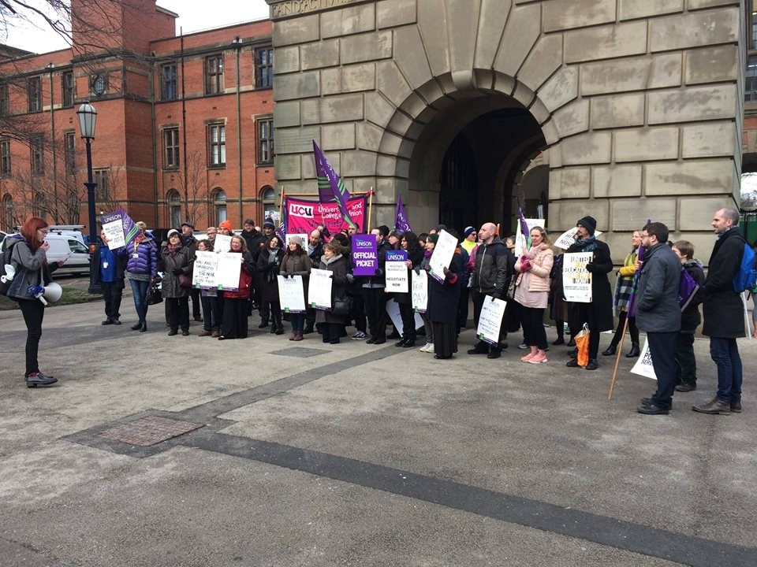
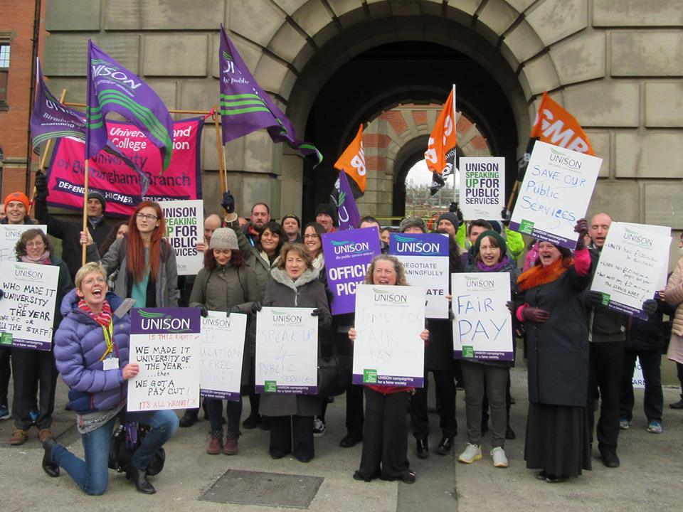
2017/2018 Protest
Protest for Fair Pay
29th November

Slide 6
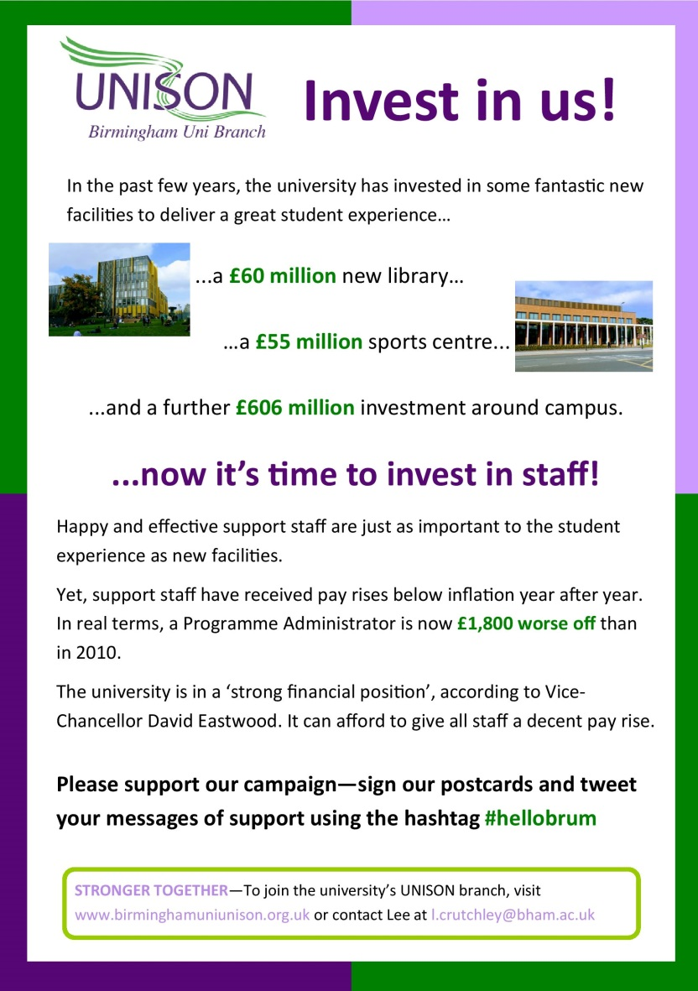
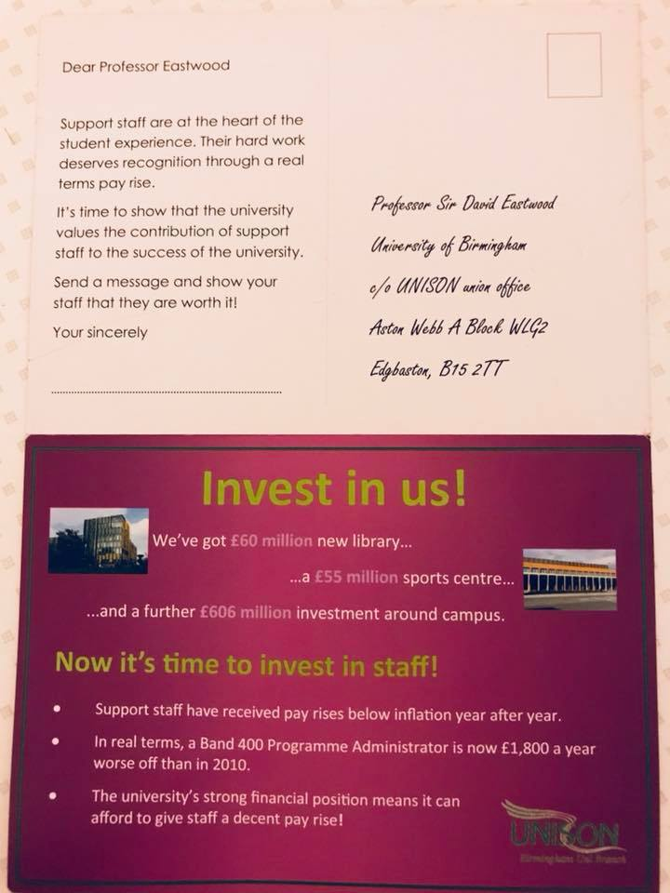
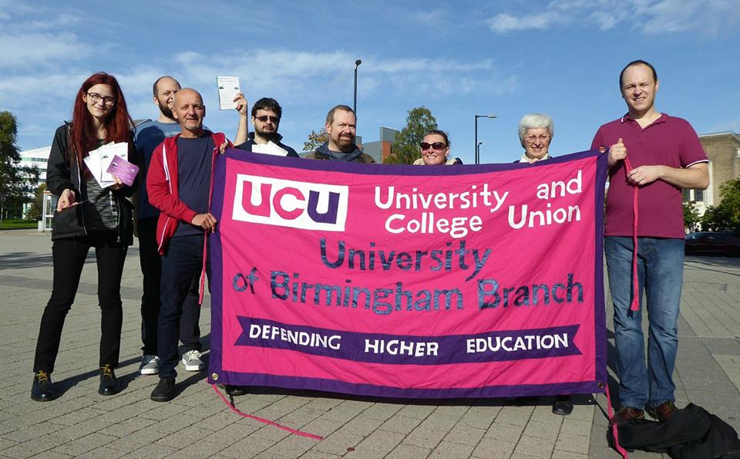
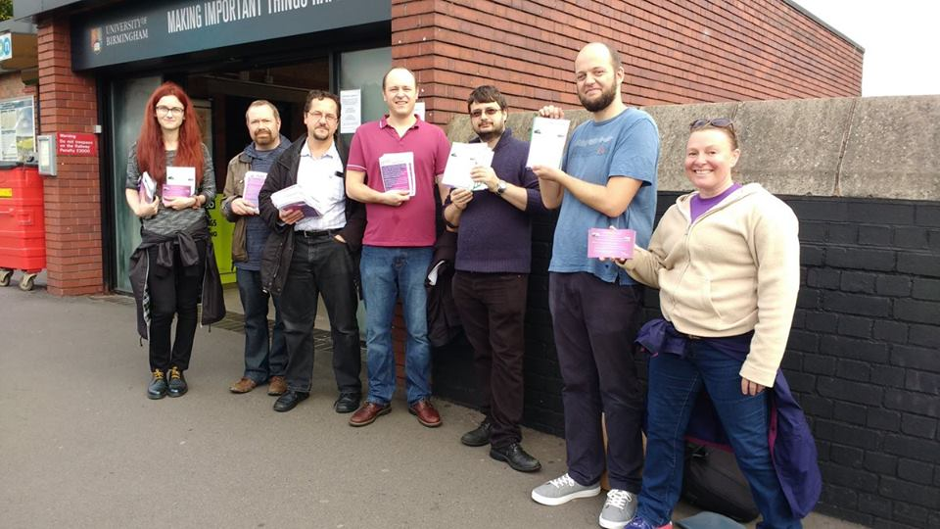
2017/2018 Leafleting
University Open Days
October 2017 & January 2018

Slide 7
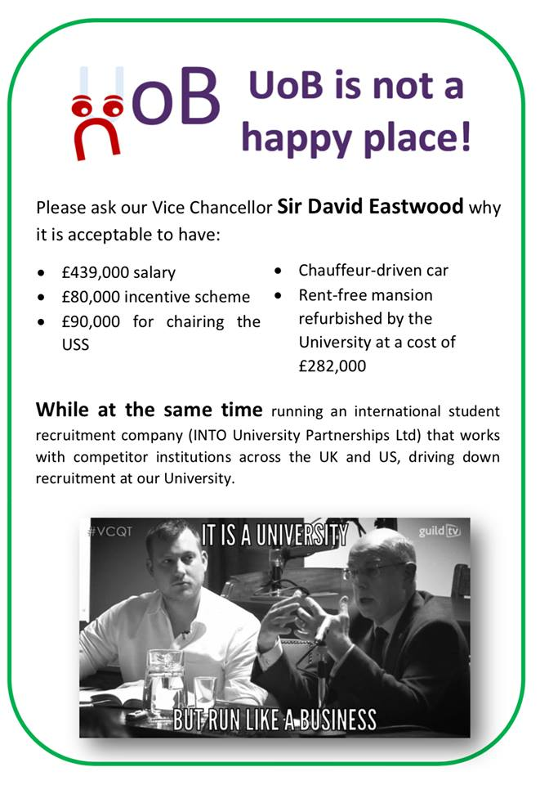
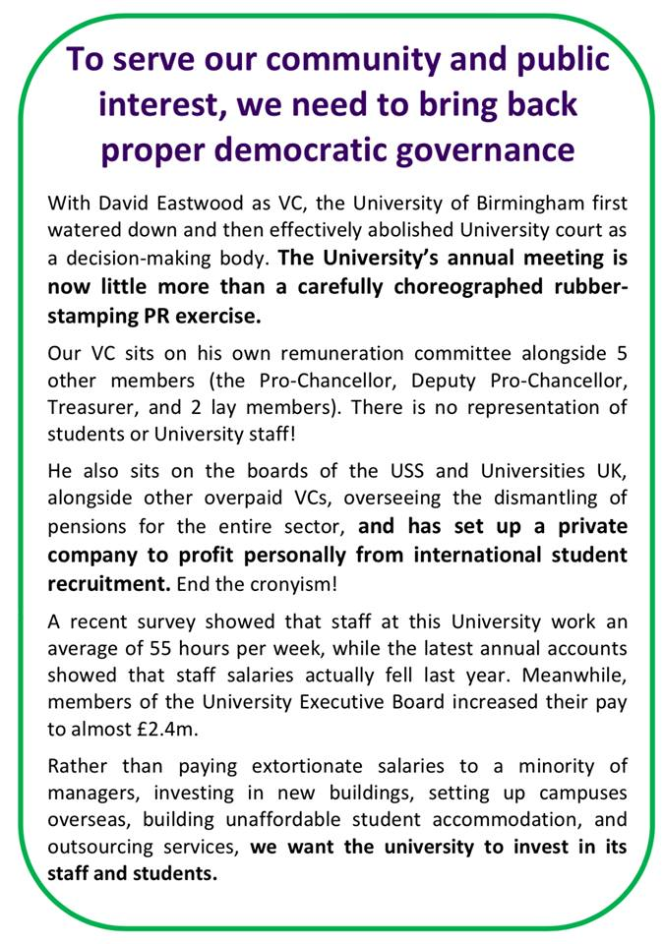
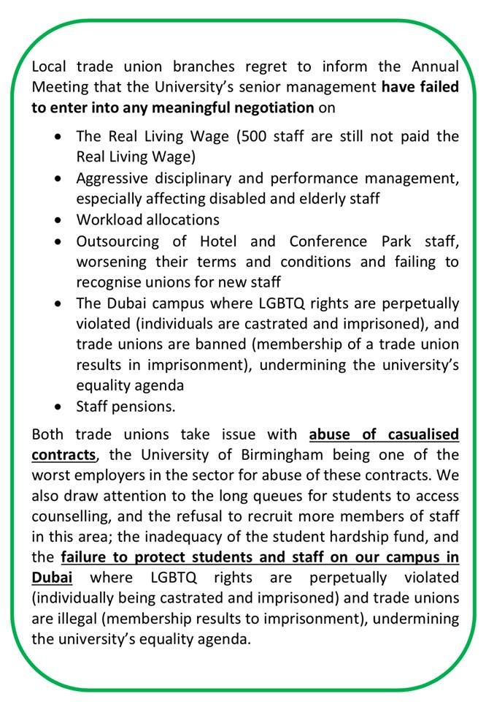
2017/2018 Leafleting
University Annual Meeting
8th March 2018

Slide 8
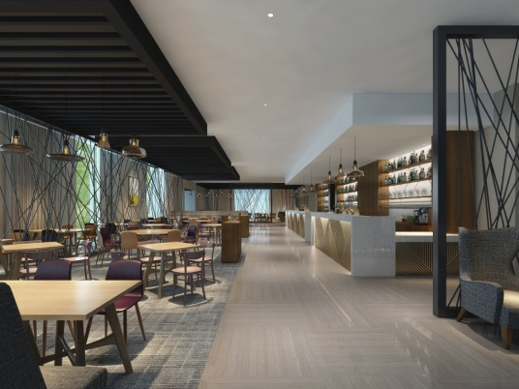
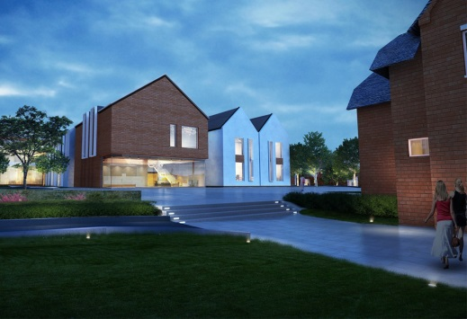
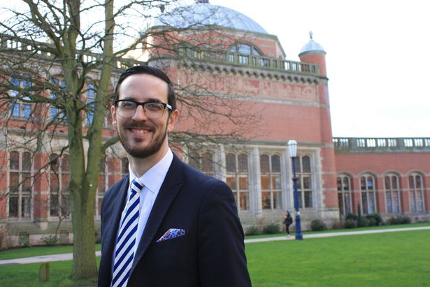
Greed and outsourcing at Hotel & Conference Park
Number of beds and rooms will grow x 4
Number of staff will grow x 2
Risks:
Increased workload
Increased bullying of current staff, so as to ‘willingly’ leave their jobs and be replaced by new, cheaper staff
Refusal to recognise unions for new staff
Hiding intentions regarding disciplinary action against staff who don’t meet newly imposed, draconic, metrics-driven targets
Staff to work on university closed days and religious days
Overtime payments, annual leave and sick pay to be affected
Two-tier workforce
The university is not a business, but they’re trying to run it as if it is!
Richard Metcalfe, general manager of the new Hotel and Conference Park
Conflict of interest – Richard is involved in setting up criteria for incentives and disciplinaries, including for himself.

Slide 9
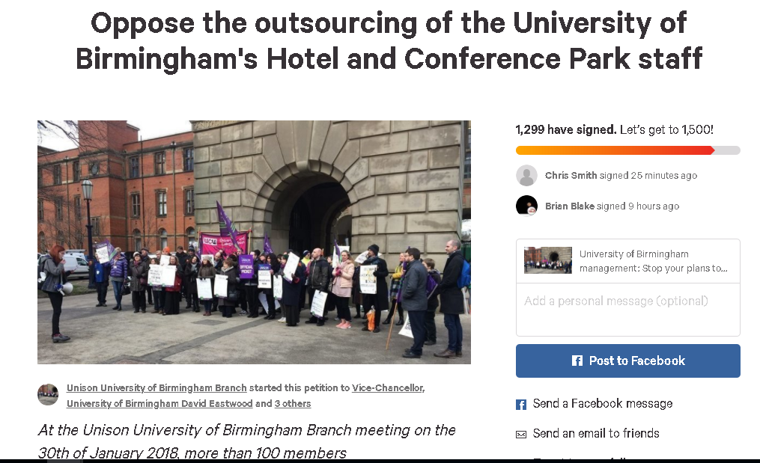
2017/2018 Petitioning & balloting
Oppose the outsourcing of Hotel and Conference Park staff!

Slide 10
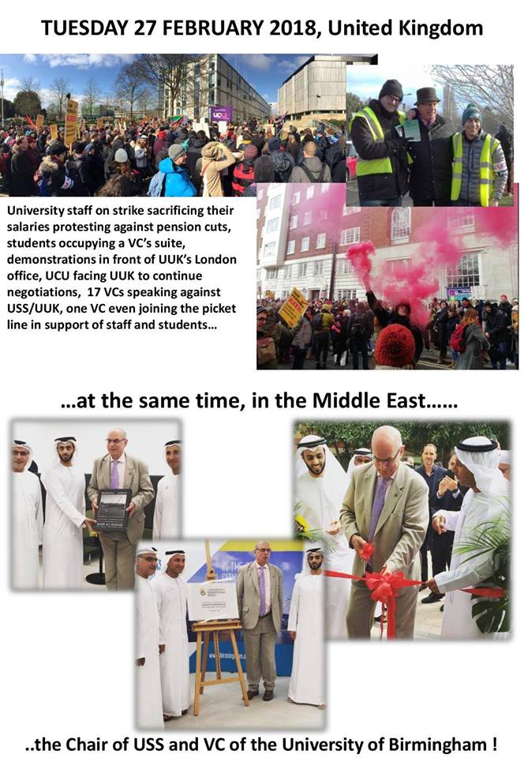
Campus in Dubai
The motion against the opening of a new campus in Dubai, passed at a members’ meeting in January 2018:
Condemns the university management’s decision to choose Dubai as a close business-partner and specifically as the place to open a second campus. This decision contravenes with the University's own stated equality and diversity policies.
Main issues:
human rights violations against LGBTQ people, migrant workers and members of independent trade unions.
The university management have failed to guarantee student and staff protection in Dubai
The Curriculum itself will be shaped by Dubai’s censoring laws.
Credit for the photo collage
goes to UCU Birmingham

Slide 11
2017/2018 Newsletters
Summer 2017 & Winter 2018
Special thanks to Vera Kubnez!

Slide 12
2017/2018 Casework
We have handled well over 100 cases over the past 12 months, of varying complexity
Special thanks to Lee Crutchley, Michael Moore, and Matt Raine!

Slide 13
2017/2018
.. And more!
Branch meetings
Welfare enquiry
Motions passed: on the pay dispute (campaigning); on the Dubai campus; for an indicative ballot
To be covered by Matt later:
Car parking
Living Wage
Weekly pay
Security
College of Arts and Law Performance Review

Slide 14
FUN plans!
FILM SCREENING & OTHER SOCIAL EVENTS!
Any ideas? Let us know!
Want to help? Even better ☺

Slide 15
Health and Safety Report
H & S inspections – notably, at the Hub and the new Library
Other matters (Mike to report)

Slide 16
OFFICER ELECTIONS

Slide 17
Roles available
Nominations received in advance for:
Chair
Secretary
Deputy Secretary
Health and Safety Officer
Women’s Officer
LGBTQ members’ officer
branch chairperson
branch secretary
treasurer
education co-ordinator
lifelong learning co-cordinator
equality co-ordinator
health and safety officer
communications officer
membership officer
international officer
young members officer
welfare officer
women’s officer
Black members’ officer
LGBTQ members’ officer
disabled members’ officer
Labour Link officer (elected by APF payers).

Slide 18
Chair – candidate(s)
Ioana Cerasella Chis

Slide 19
Young members’ officer – candidate(s)
Robert Eagleton

Slide 20
Communications Officer & Equality Officer – candidate(s)
Paula Douglas

Slide 21
Welfare Officer – candidate(s)
Paul Butler

Slide 22
Secretary – candidate(s)
Matt Raine

Slide 23
Deputy General Secretary – candidate(s)
Lee Crutchley

Slide 24
Health and Safety Officer – candidate(s)
Michael Moore

Slide 25
LGBTQ members’ Officer – candidate(s)
Claire McHale

Slide 26
Women’s Officer – candidate(s)
Alison Dingle

Slide 27
Motion on Senior Staff Pay and the Living Wage
The University is a large and successful international organisation that regularly boasts of its own academic and financial successes. It regularly uses this self-proclaimed success as a means to attract high quality students and managers.
The University defends high senior salaries by claiming market value but then paradoxically refuses to pay the living wage by citing uncertainty and financial instability. If senior managers were achieving their objectives, surely the university could afford to keep their lowest paid colleagues out of food banks.
This branch calls upon the University, a charitable organisation that receives millions of pounds of taxpayer’s money and organises sustained appeals for charitable donations, to:
* Explain its decision to pay its highest earning 44 members of staff a staggering £8 million-plus per year from the University’s resources
* Implement a fairer remuneration structure across the University
* Publicly affirm that they will become an accredited living wage employer and commit to paying the real living wage each year when it rises in November
We call for senior management to be paid no more than 10 times the lowest paid member of staff at the university.
Submitted by Alison Dingle, Women’s Officer

Slide 28
Hotel and Conference Park member’s report

Slide 29
Secretary’s report
Hotel and Conference Park – indicative ballot
Security
Performance Review in the College of Arts and Law
Pay

Slide 30
Guest speaker Dr Roland Brandstaetter, UoB UCU branch President

Slide 31
Contact details & Social Media
Email: unisonbham@adf.bham.ac.uk
Phone numbers: 0121 414 7622 or 0790 496 0442
Facebook: https://www.facebook.com/bhamuni.unison (Unison Birmingham Uni Branch)
Twitter: https://twitter.com/BhamUniUnison
Website: http://www.birminghamuniunison.org.uk/

